Slide 1
Initiatives under NRLM to end witch hunting and branding practices
Neelesh
SISD and Gender team of NRLM, Delhi

Slide 2
Witch hunting and branding practices in India

Slide 3
Witch hunting and branding practices in India
More than 15 states/UT have reported Witch Hunt as the motive of murder between 2016 to 2020 in India. (as per NCRB)
Between 2016-2020 about 460 women have been reported to be killed in the witch hunts across the country.
Jharkhand, Chhattisgarh, Madhya Pradesh and Odisha are the states which together reports more than 70% of the cases.
Some of the states like West Bengal, Assam, Meghalaya, the reporting of the crime has gone down to almost 0 in the last 4 years.
The reported figures in UP, AP, Telangana, Rajasthan are very fluctuating. They report 0 in one year and double digit in the next.

Slide 4
Takeaways
These figures do not report on the motive behind other atrocities, if not murder, like Rape, other forms of violence.
Witch Branding, though has been declared as crime in several of the states, are not being recorded/reported specifically by the NCRB.
No learning emerged from the states where the figures have gone down drastically so far. May be a separate study would be required.

Slide 5
What exactly are the issues
Cases are not reported/ not encouraged to report.
Witch Branding not considered as serious enough to take any action in the initial stages until the victim is killed or raped
The perpetrators ensure support from every household either through threats or out of sharing the same believe system.
No efforts are made to make people talk about the issue
No Witnesses. In some of the cases even the liability of proving the crime have been put on the victim herself.
Lack of Psychological and legal Counsellors at the community level
Police and Courts are not considered as one of the practical options at all by the villagers
‘No All’ Attitude of the policy makers make them completely close their eyes and brains to the emerging learning from the field and research studies.

Slide 6
There are two factors behind the Witch Hunting/Branding
E
External : Witch Doctors, Property Conspiracy, Availability of Education, health services, effectiveness of the Justice/Legal system, Women Safety status, Gender equality in the society etc.
Internal: Believe system, access to decision making, Voice in the family/society, economic independence, personal access to the legal, education, health services, Awareness regarding rights and entitlements, Gender sensitization within, etc.
I

Slide 7
What exactly the Government does for the prevention of Witch Hunting
Form tougher laws
Awareness generation
However, No audits so far been done of either of the cases pending in the courts or of the Awareness Generation Campaigns which are carried out year after year as one sided communication.

Slide 8
What we do in NRLM (National Rural Livelihood Mission)
Centrally sponsored schemes running since 2011
The goal is to eradicate poverty through women’s owned and managed institutions and its federations.

Slide 9
Federation Model
BLF
•
E.C
-
2 from each V.O, 5 Office bearers
•
Support to VOs
•
Secure linkage with Govt.
Depts.
fin institutions, markets
•
Auditing of the groups
15-30 VO
•
Micro Finance functions
CLF
•
E.C
-
2 from each S.H.G, 5 Office bearers
-
•
Strengthening of SHGs
•
Arrange line of credit to the SHGs
•
Social action
•
Village development
10-25 SHG
V.O
•
Marketing and food security
•
Support activists – 3 -5
-
•
Thrift and credit activities
•
Monitoring group performance
•
Micro Credit Planning
SHGs
SHGs
SHGs
SHGs
SHGs
SHGs
•
Household inv plans
10-15 SHG

Slide 10
Three Pronged Strategy adopted under NRLM
Prevention
Protection
Prosecution (access to Justice)

Slide 11
Institutional mechanism created
The NRLM is working on these 3 Ps for all forms of violence against women including WH and WB.
About 28 states and 1 UT in India have their Gender operational strategies in place.
The states are identifying the issues to be addressed as per their local context.
Jharkhand is implementing special project to end Witch Hunting and Branding Practices in the state.

Slide 12
Institutional structure
State
Core Team
SRPs ( 6-10 members, minimum 50% Other than Mission staff)
District
DRPs (4-6/district, Mission staff, Community, Others – minimum 50%)
Block
Gender forum ( BDO, Health, Education, ICDS, RWS, Revenue, Police, ICP, CLF SAC, 2 GPPs
CLF
3-4 CRPs @ one per 7-8 VOs
Social Justice Centre
GP
Gender forum (VO SAC, 2 GPPs, Sarpanch, 2 Women Ward members, ANM, ASHA, AWW, VRO/Secretary)
VO
SHG
CLF SAC ( 2-3 Members, 2 active GPPs)
VO SAC (2-3 Members, 2 Active GPPs)
GPP/SHG

Slide 13
Key Strategies
Prevention:
  Sensitization and capacity building of CLFs and VOs for leading the project
  Vulnerability Mapping and linking them with NRLM and other government schemes
  Formation of Protection Team at the village level for regular awareness generation and prevention activities.
  Introducing Witch Hunting Prevention in the training curriculum of different stakeholders
  Formation of Badlao Manch (Gender Forum) in every village and Badlao Didi in every SHGs
  Theatre of Oppressed approach for initiating dialogue in the villages
  Engagement with Youth and children
Protection and Justice:
  Adoption of Multiple approaches for identification of victims
  Formation of Special Cell at the Police Station with the help of TSA
  Establishing Community Managed One Stop Centres at the Block level.
  Conduction of Public Hearings at Block, District and state levels.
  Helpdesk for survivors and vulnerable families at the VO, Panchayat and CLF to ensure personalised services.
  Immediate Psychological and legal counselling and services
  Development of Survivor wise action plan for Livelihood promotion and other support
  Women Safety Audit

Slide 14
Contd..
Rehabilitation
  Linking with VRF
  Personalised Healing Services to Survivors
  Livelihood Plans and services through DAY-NRLM
Capacity Building Strategy
  Creating pool of Master Trainers at the state, district and block level from the community
  Pool of Resource Organisations and experienced persons at various level
  To evolve the Capacity Building Strategy for the key stakeholders
Monitoring Strategy
  Dash board to be created at the state level to track individual survivors.
  Joint Review Committee at State, District and Block Level.
  Evolving process guidelines and monitoring strategy.
  Development of norms for declaration of Village/GP and Block as ‘Witch Hunt Free’ by District administration

Slide 15
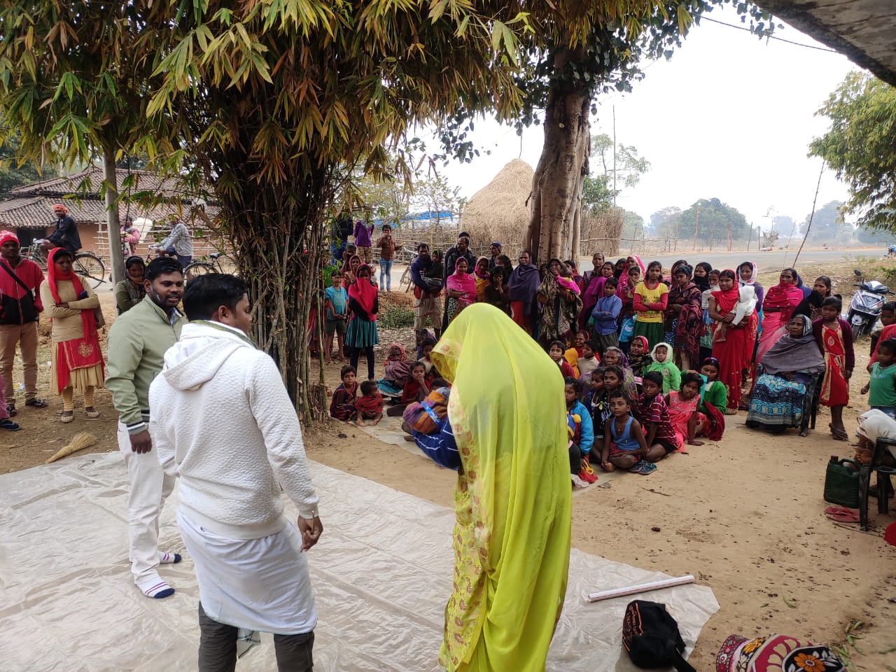
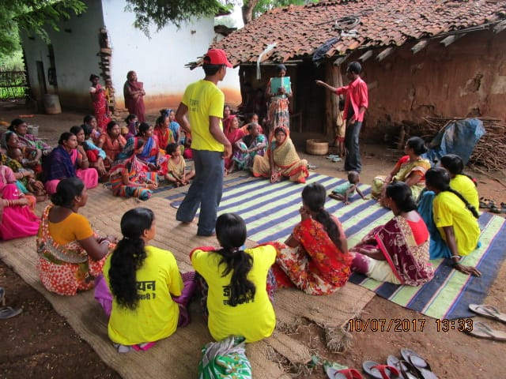
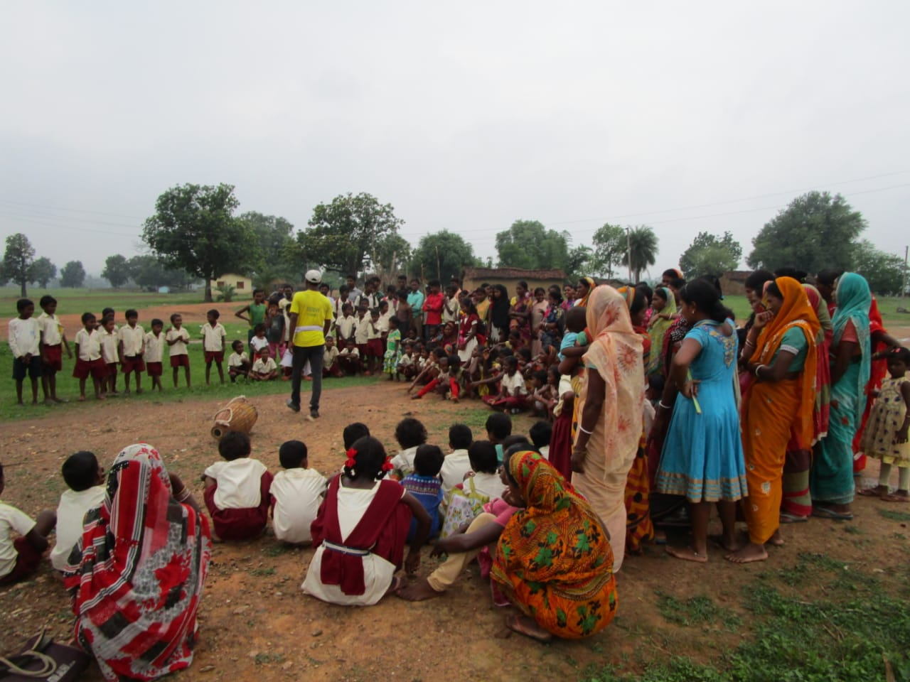
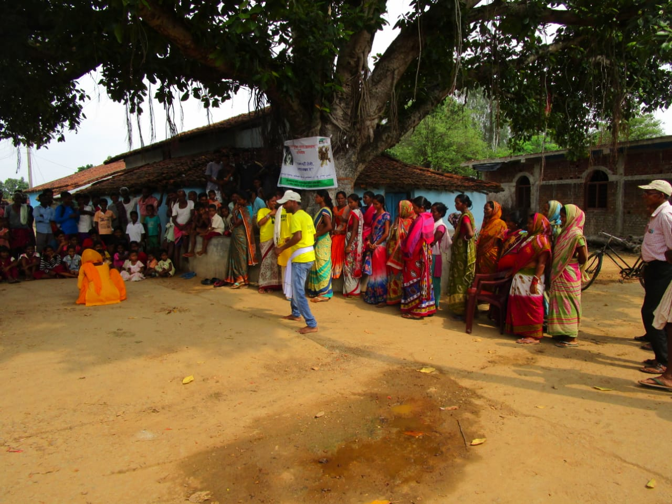
Theatre of Oppressed

Slide 16
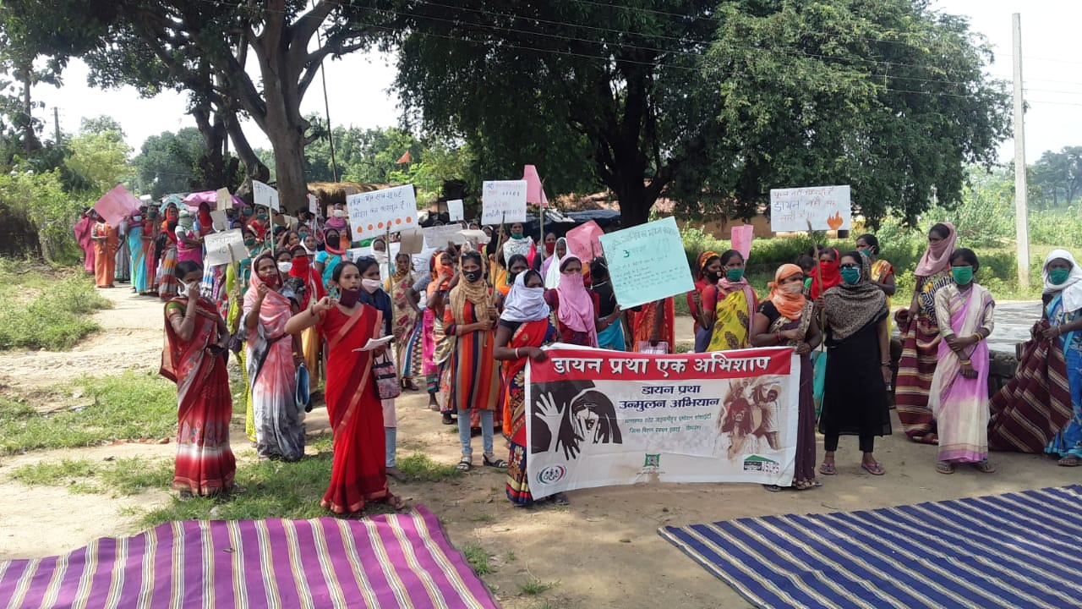
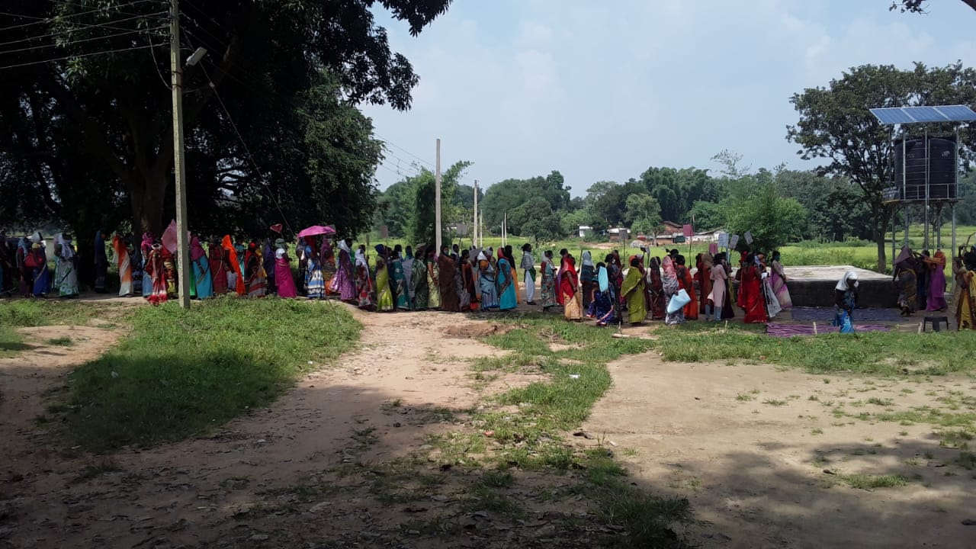
Rallis

Slide 17
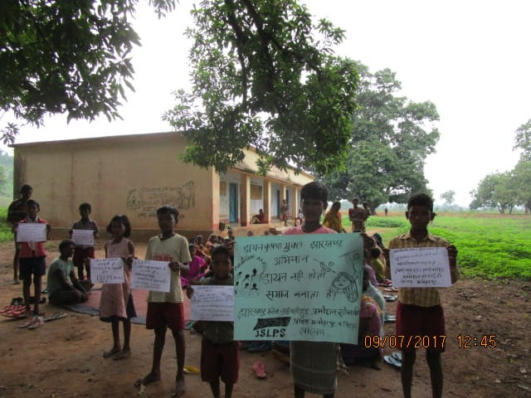
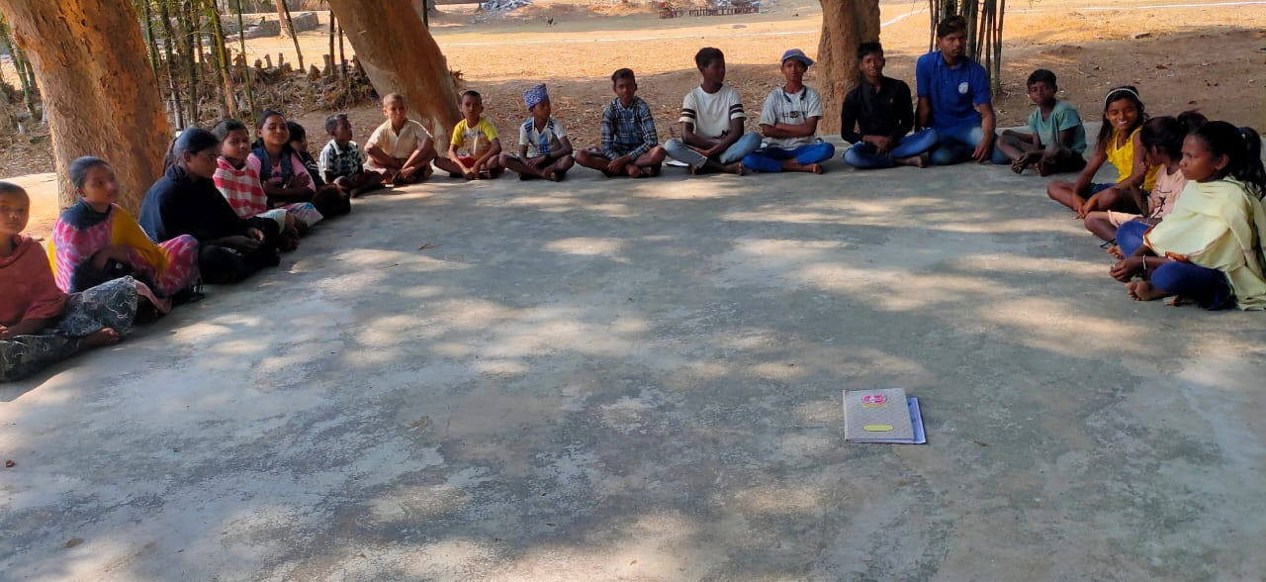
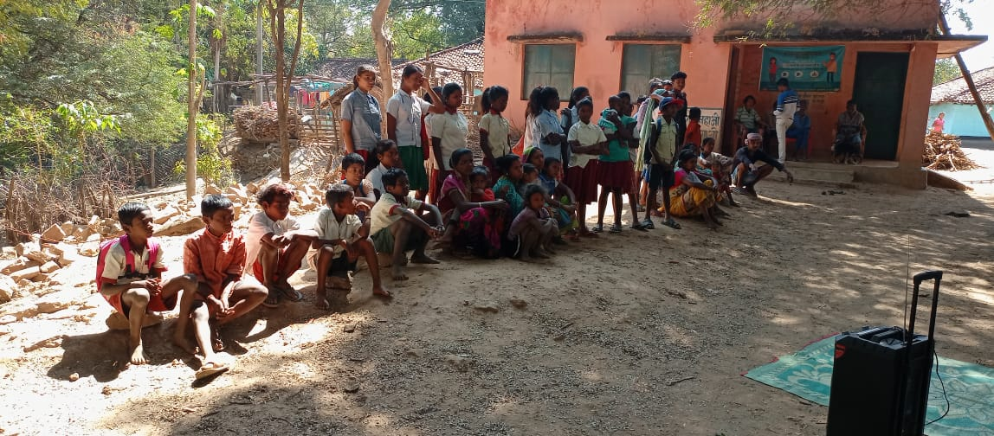
Slogan Writing and workshop with Children

Slide 18
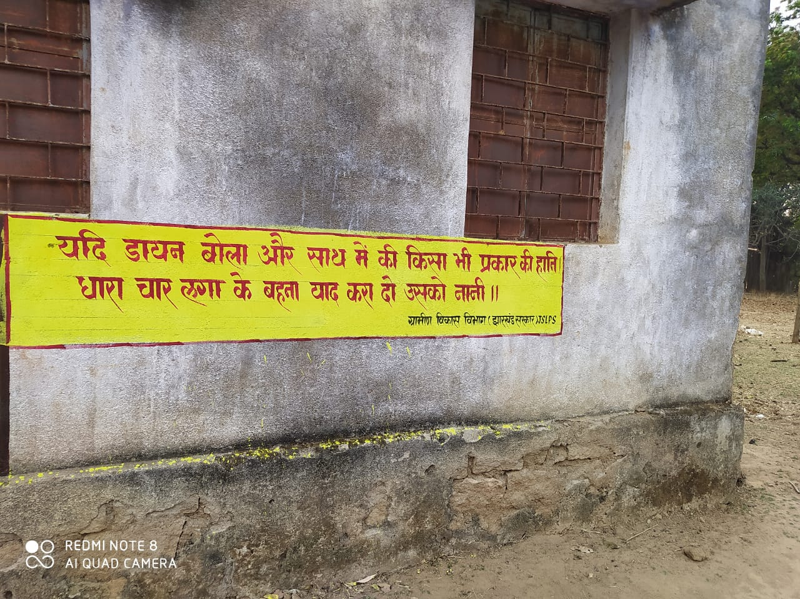
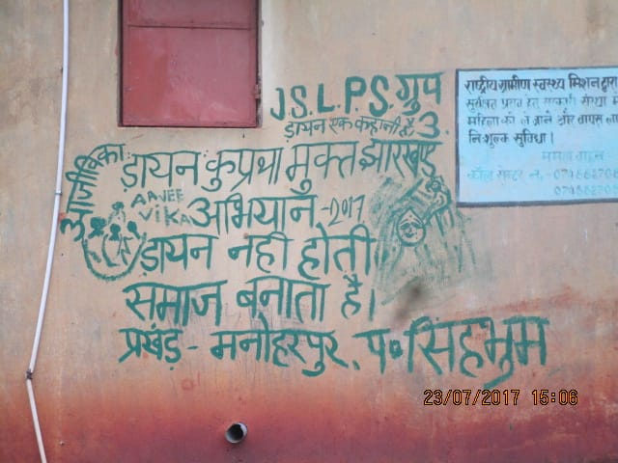
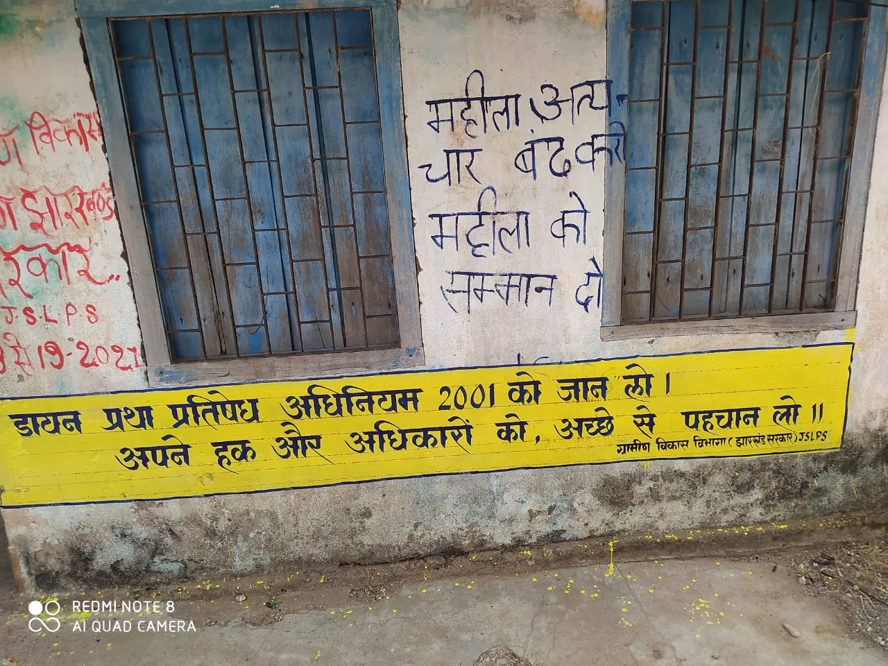
Wall Writing

Slide 19
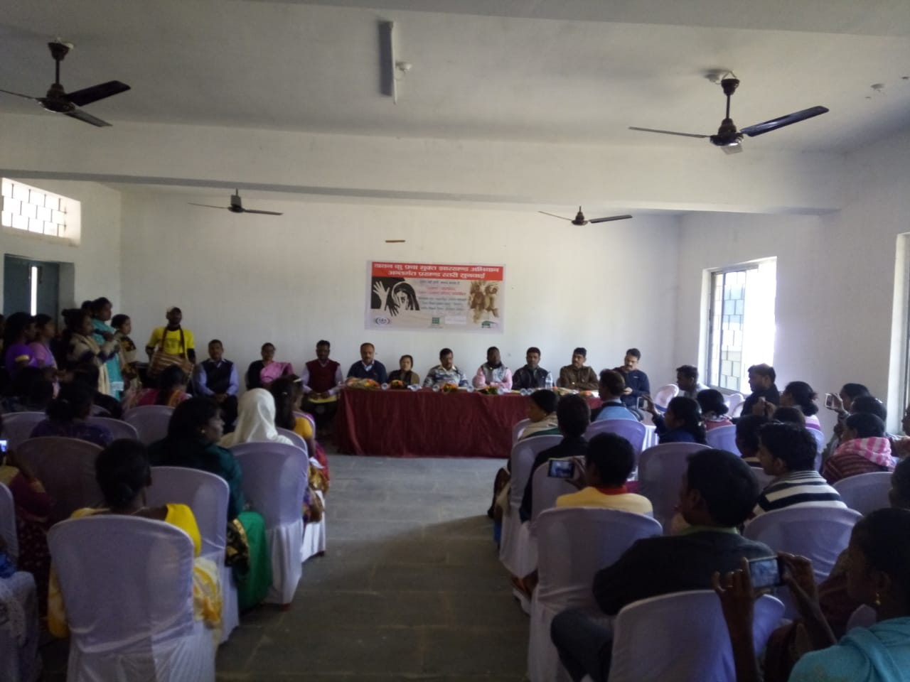
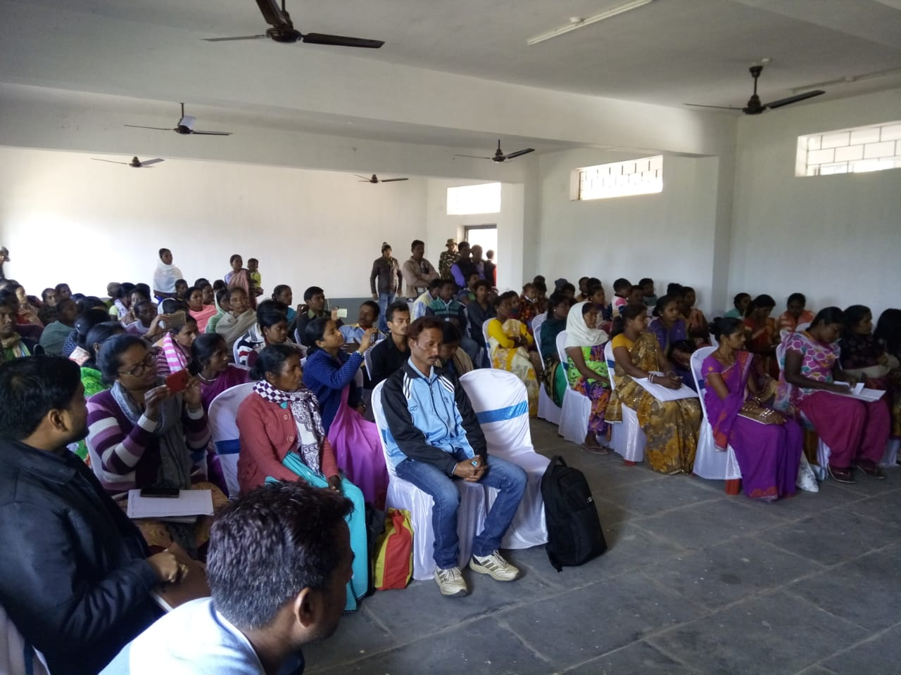
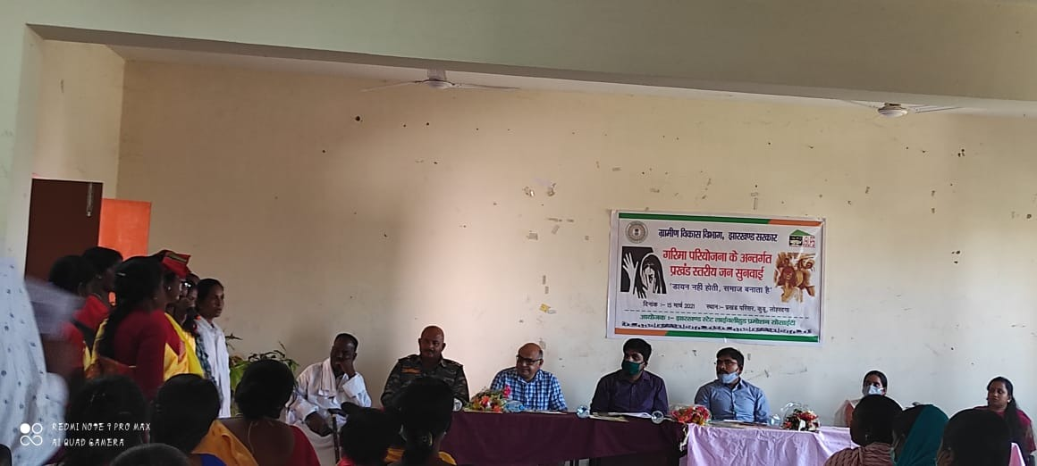
Public Hearing

Slide 20
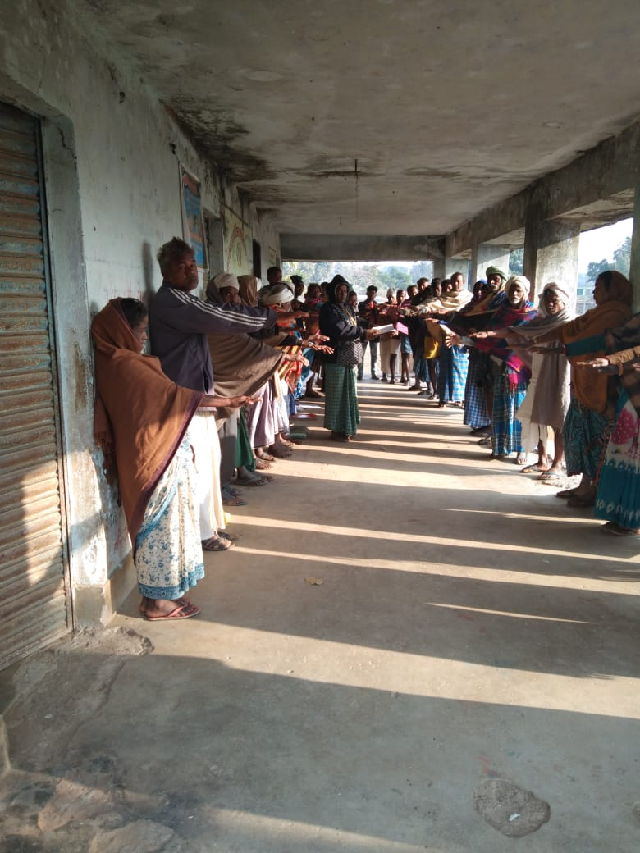
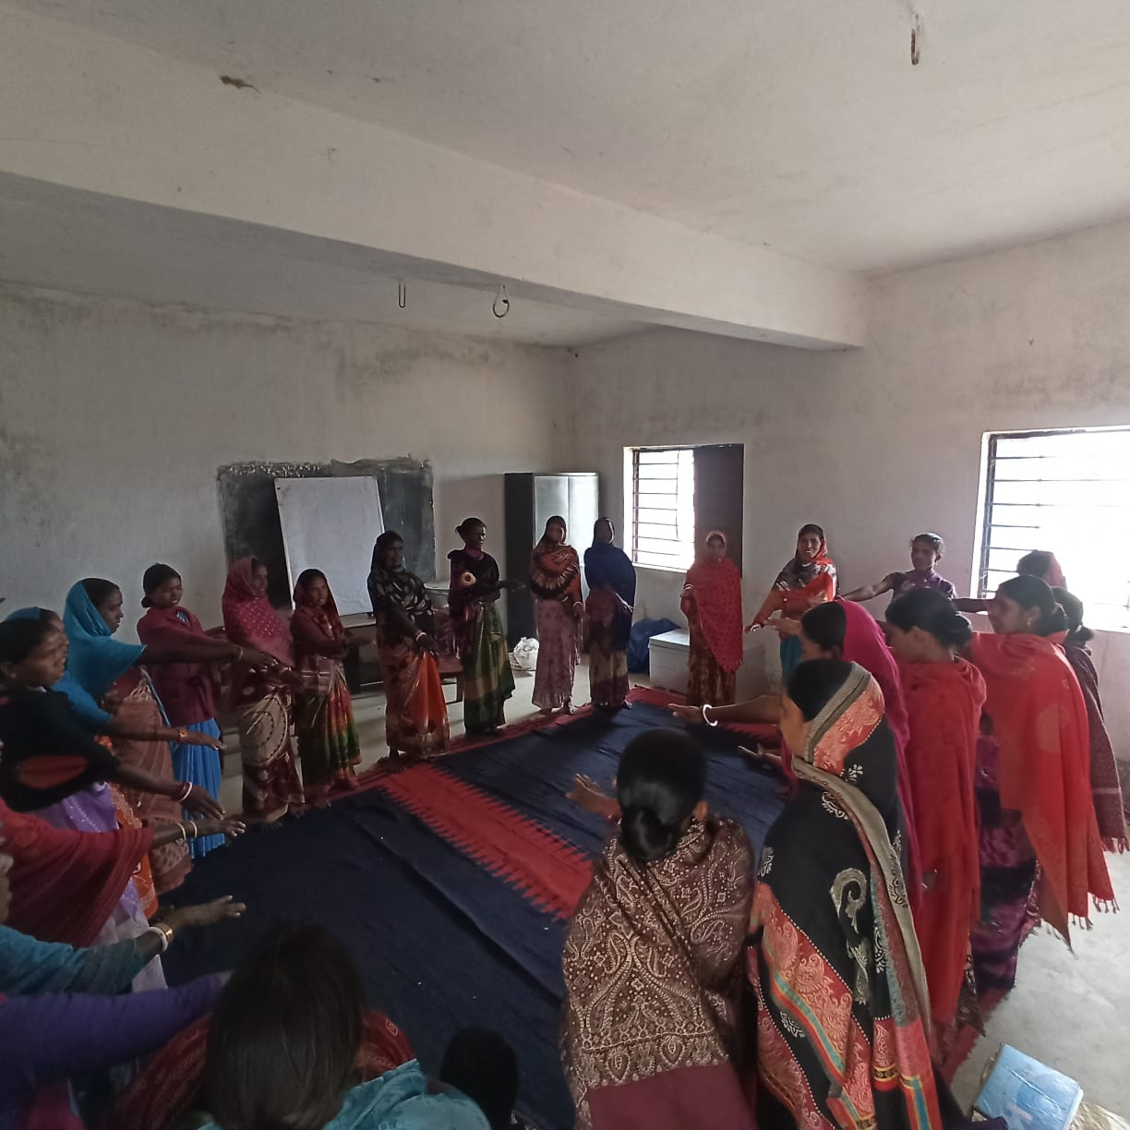
CBOs and Gram Sabhas are taking oath against Witch Hunting and Branding

Slide 21
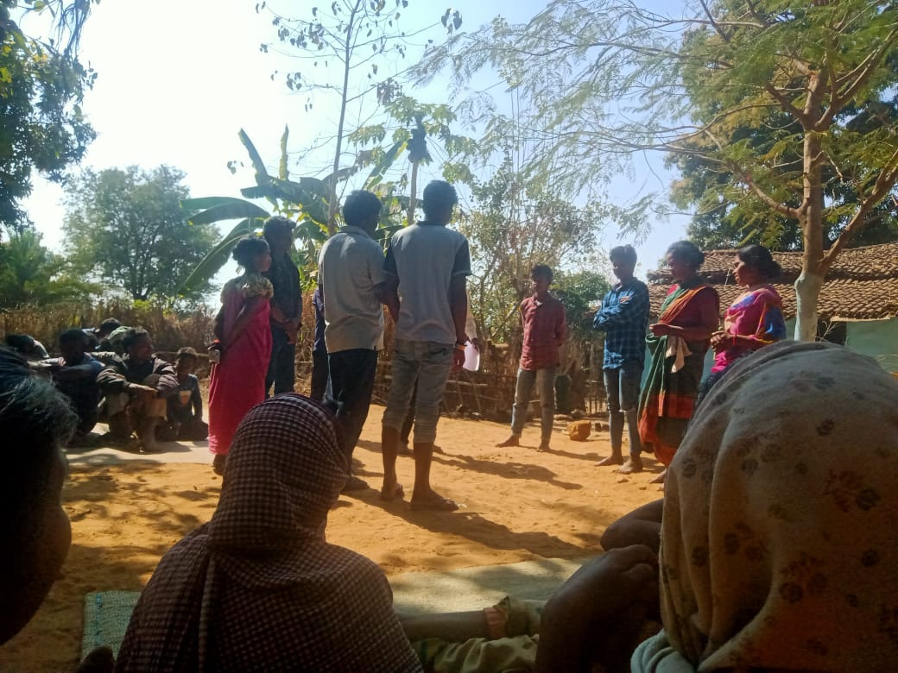
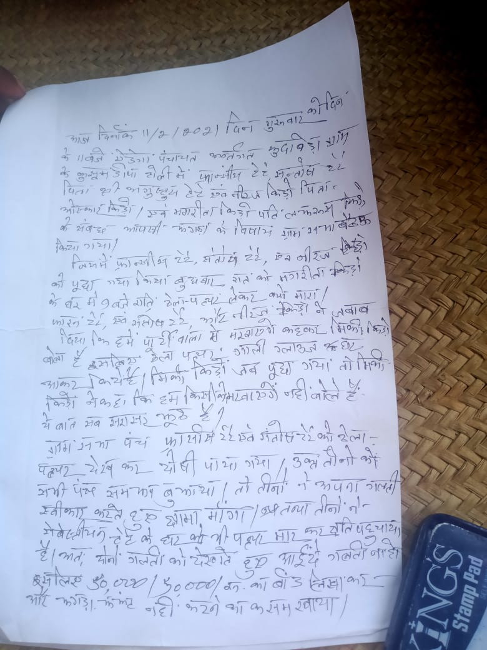
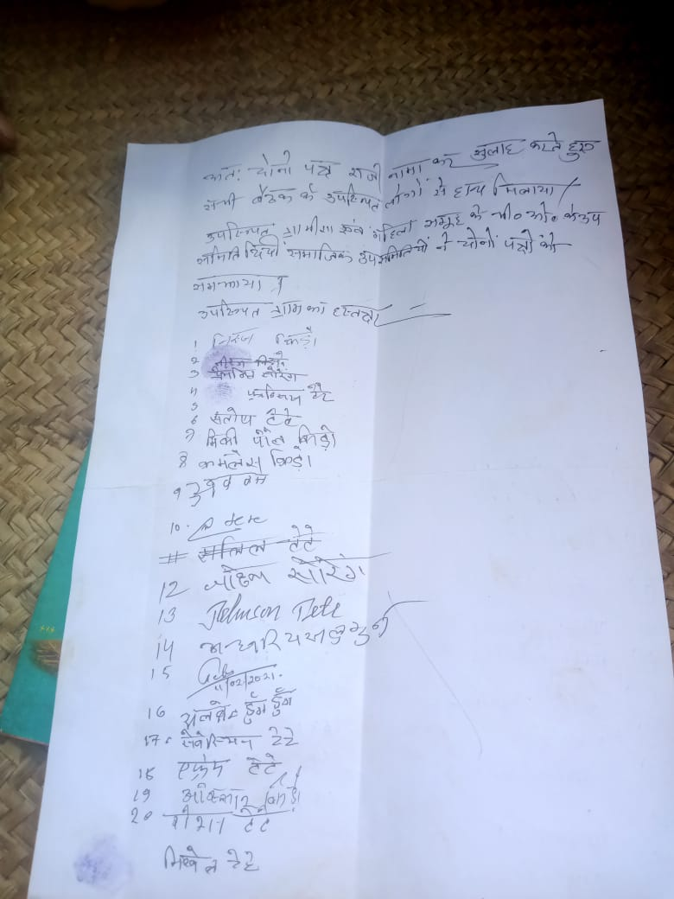
Cases are being solved by the community on the same day

Slide 22
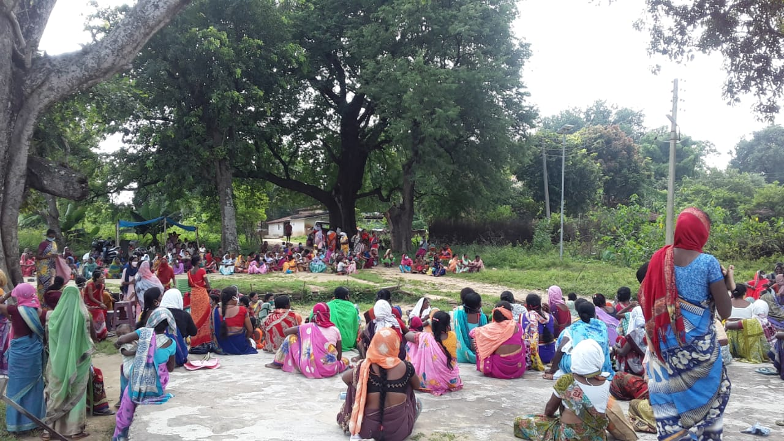
Survivors are being felicitated by the entire community

Slide 23
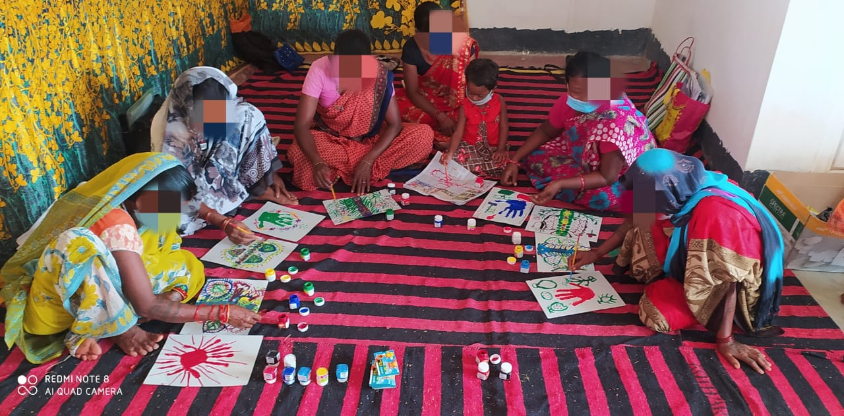
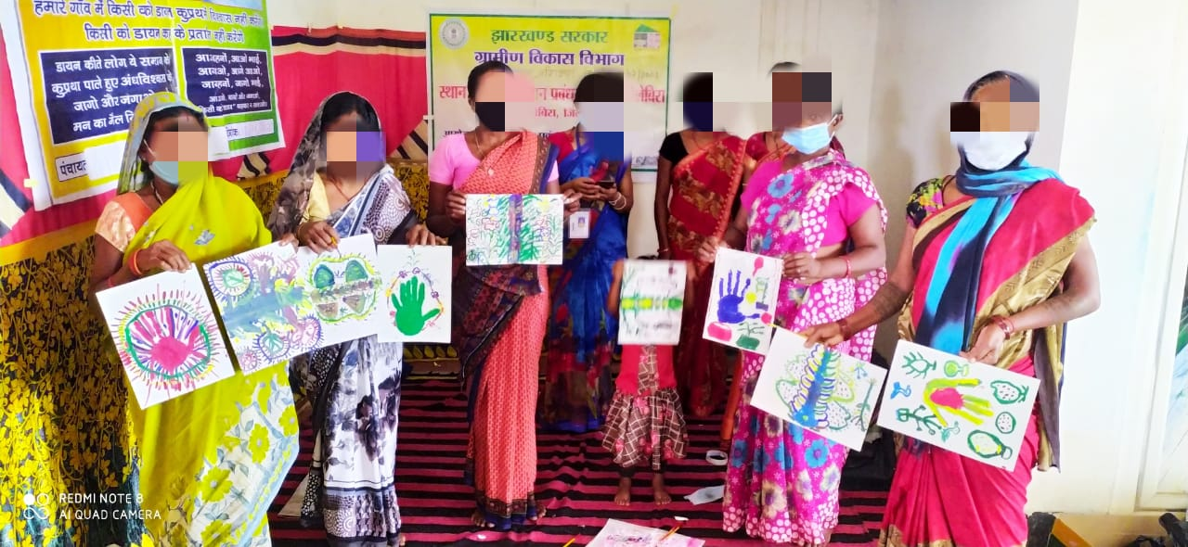
Healing of Survivors through Art Therapy

Slide 24
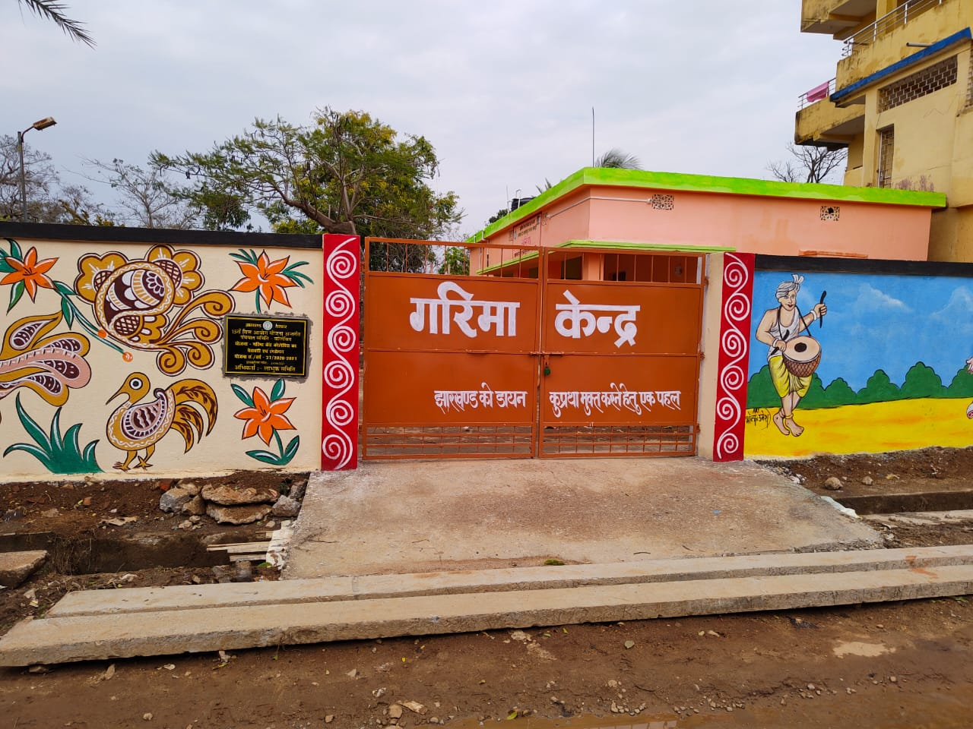
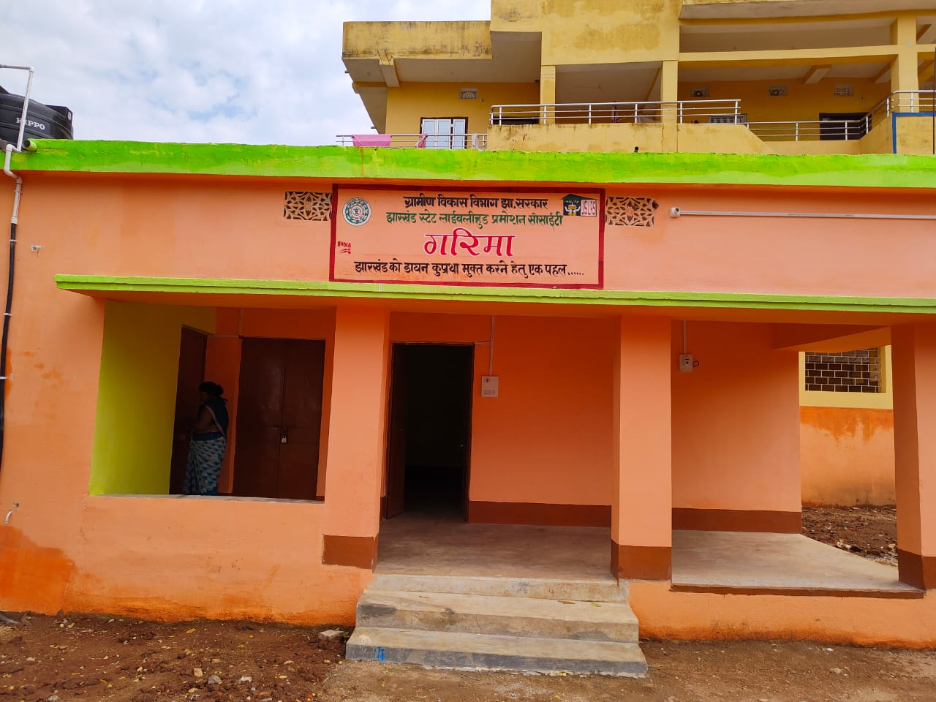
Community Managed One Stop Centre

