Slide 1
Graima: A Project to make Jharkhand free from Witch Hunting and Branding Practices
Jharkhand State Livelihood Promotion Society,
Rural Development Department,
Government of Jharkhand

Slide 2
Witch Hunting: Situation in Jharkhand
As per National Crime Record Bureau (NCRB) of India total recorded murders in the name of witch Hunting in India is 2022 (from year 2000 to 2017) out of which In Jharkhand alone the figure is 523.
As per civil societies there has been over 2000 murders in Jharkhand in past 20 years of its existence!
The evil practice is mostly found in the districts of West Singhbhum, Latehar, Ranchi, Khunti, Gumla, Lohardaga, Saraikela-Kharsawan, Bokaro, East Singhbhum and Simdega.
On an average every villages in Jharkhand would have 03 women who would be branded as witch and who are living there life in threat and isolation.

Slide 3
Garima: Project at a glance
Goal: To make Jharkhand free from Witch Hunting and branding practices
Project period: 3 years (April 2020 to March 2023)
Project Area: 2,068 revenue villages, 342 GPs 25 blocks, 7 districts
Total estimated survivors to be benefitted: 5,000
Total Project Cost estimated: Rs. 15 Crore

Slide 4
Expected Outcomes
5000 survivors are identified and are covered and protected under the CBOs of DAY-NRLM.
Income of the all the identified Survivors to be enhanced by 50%
80% of survivors shall have accessed entitlements
At least 50% of 'Violence Against Women & Children' cases would be reported within 3 Days of the incidence.
At least 10000 youths shall be leading campaign against Witch Hunting
Engaging with relevant stakeholders for formulating State Policy for Witch Hunting Prevention in place
Aim to transform the 342 Gram Panchayat and 25 Project Blocks as 'Witch Hunt Free'

Slide 5
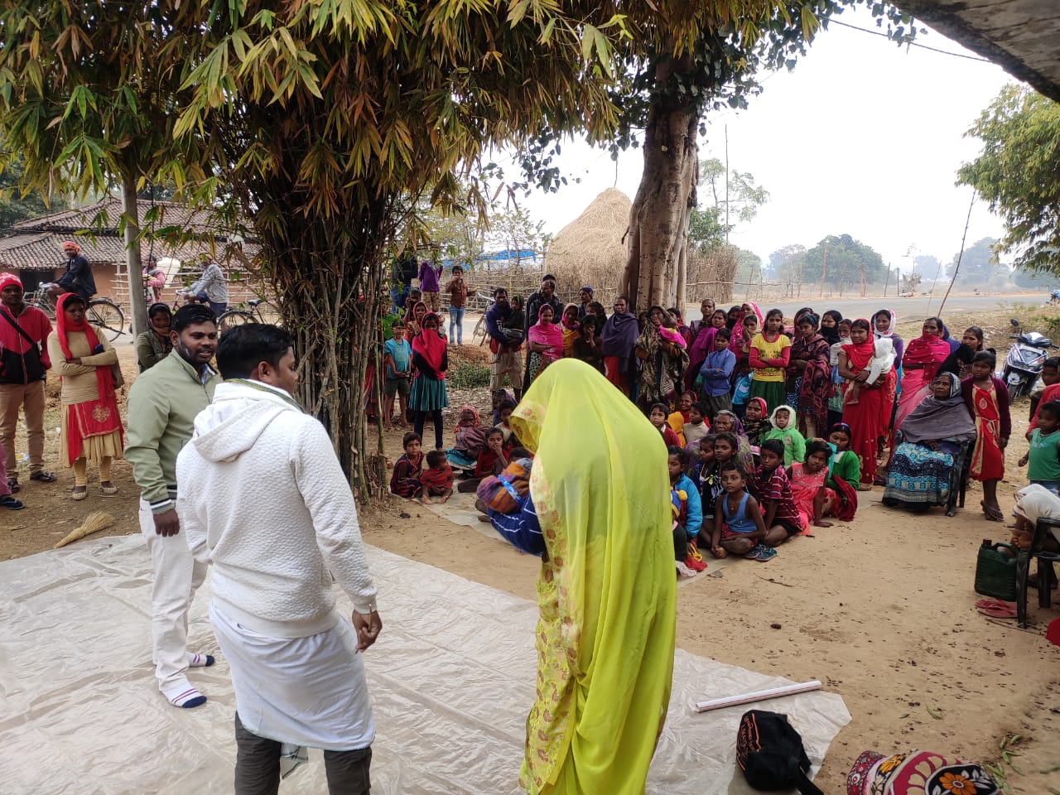
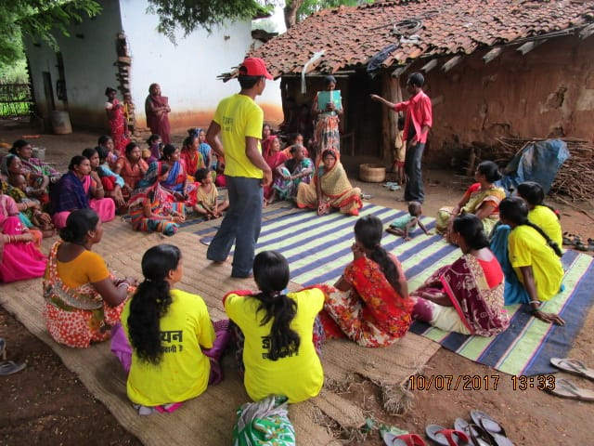
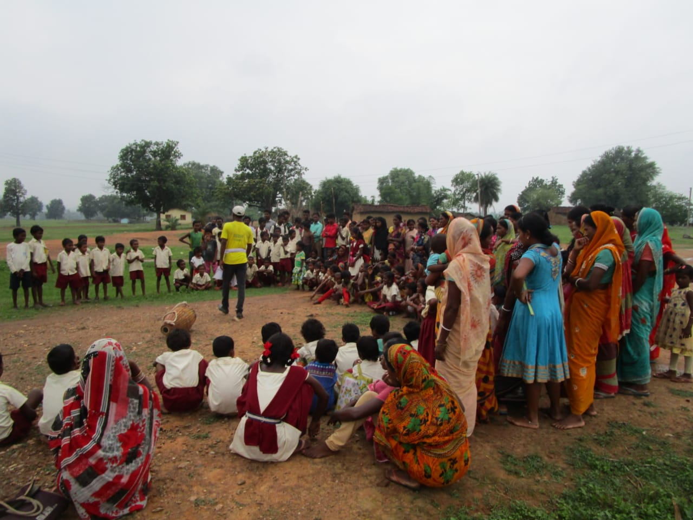
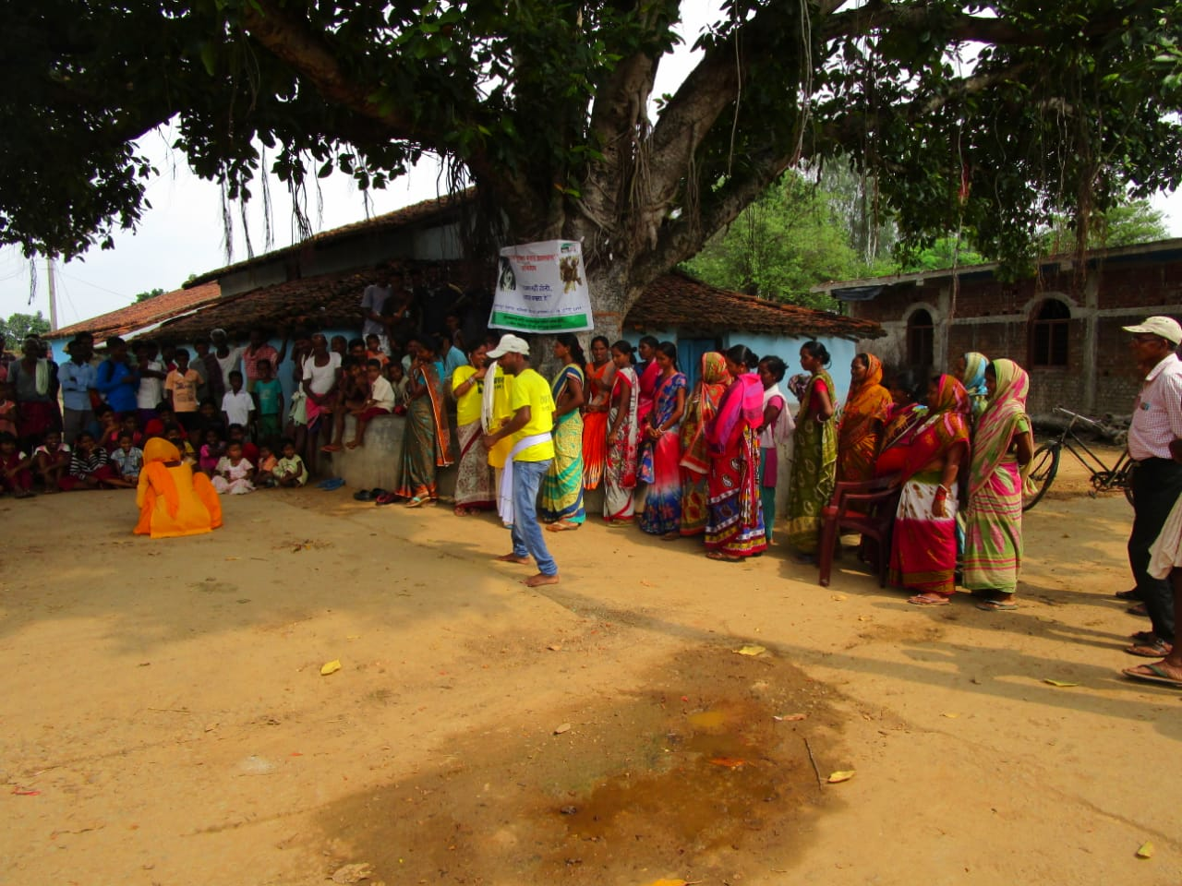
Theatre of Oppressed

Slide 6
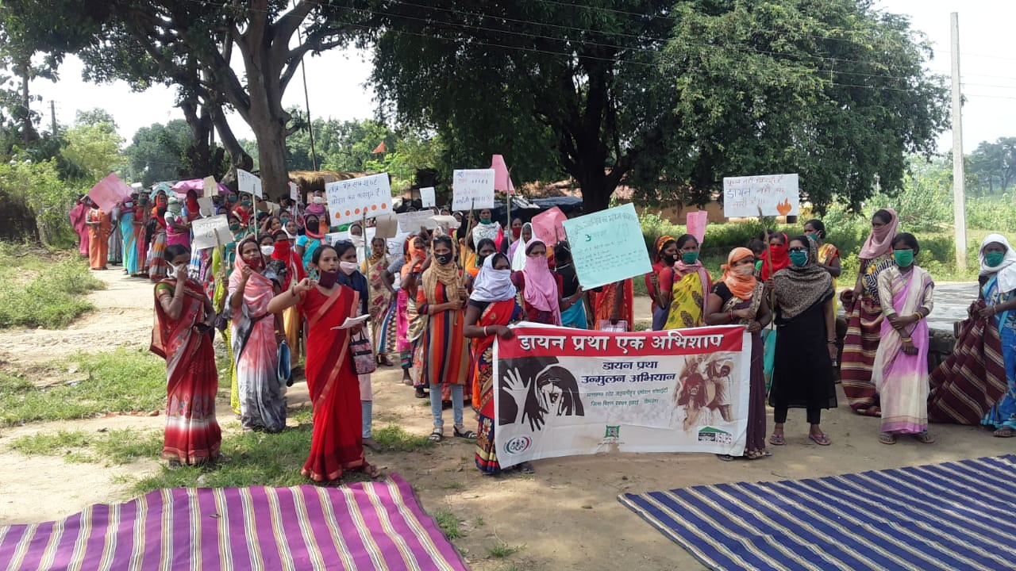
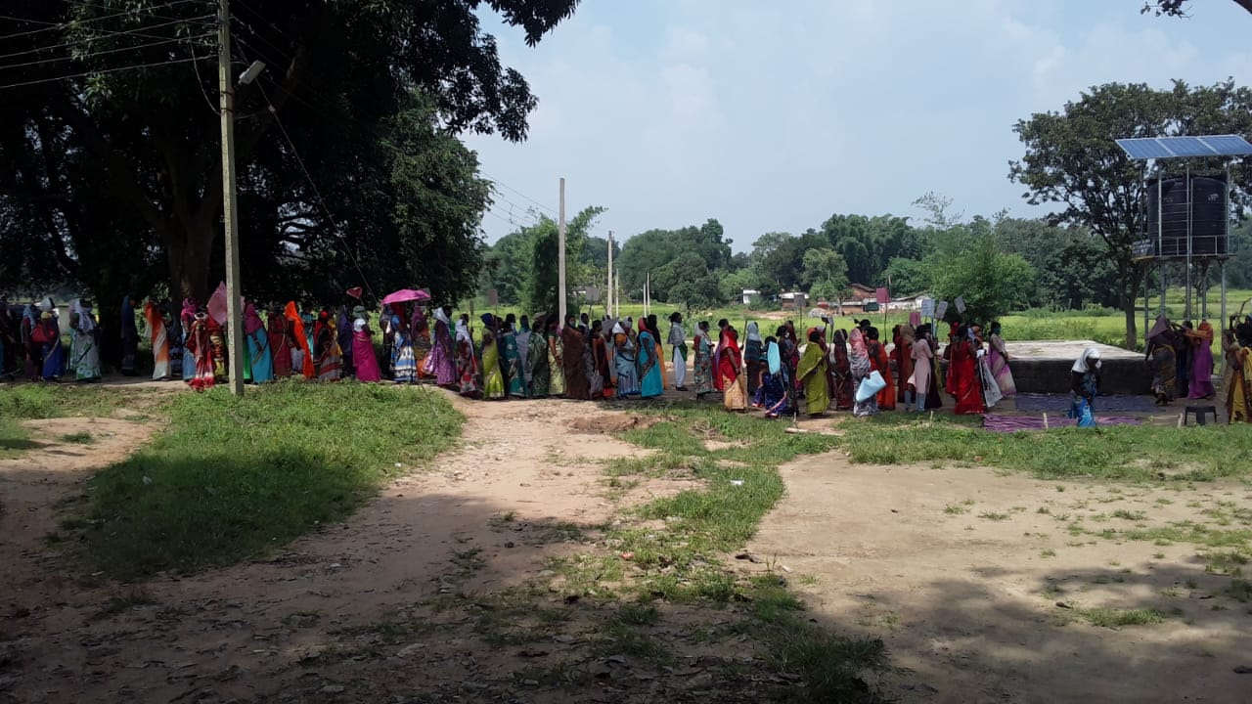
Rallis

Slide 7
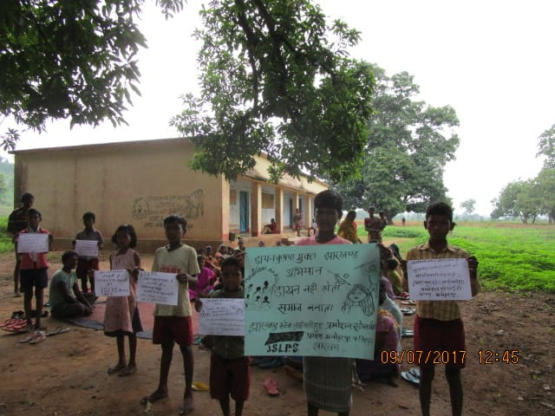
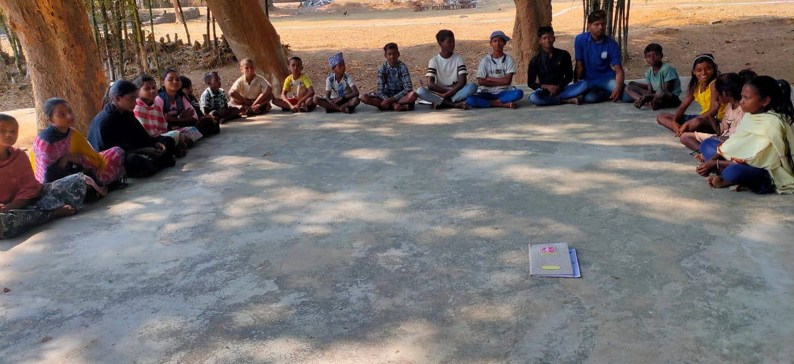
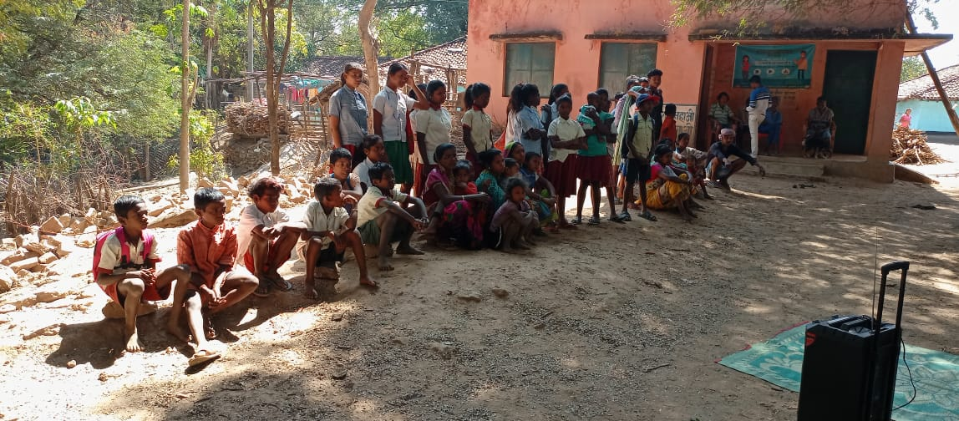
Slogan Writing and workshop with Children

Slide 8
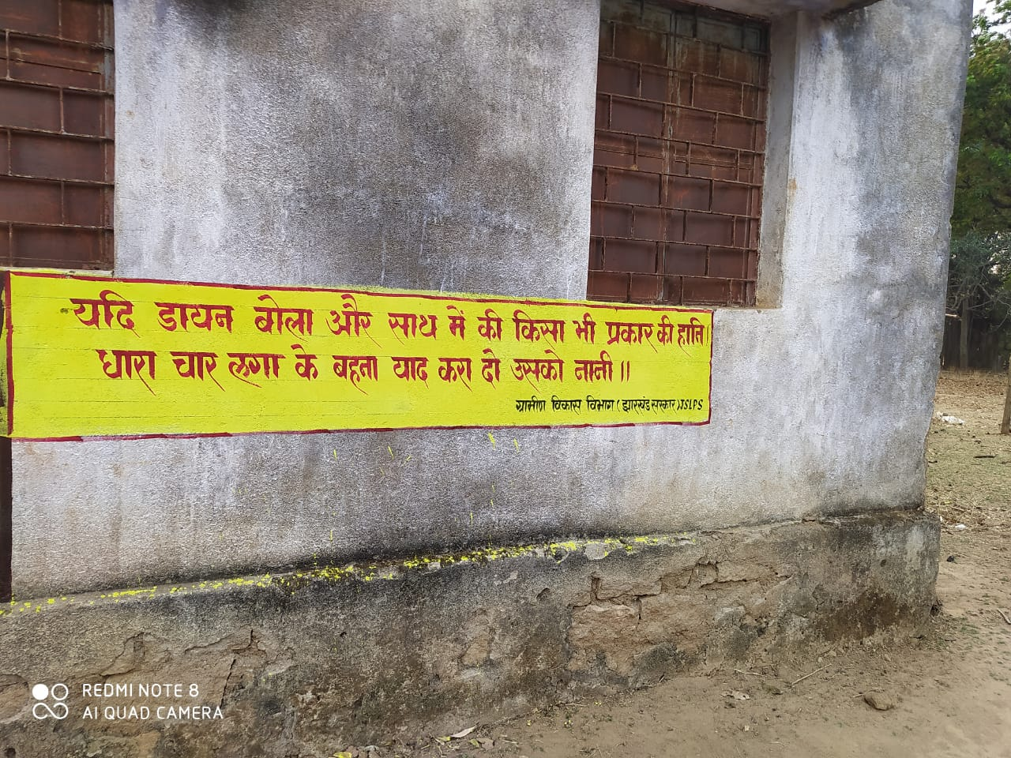
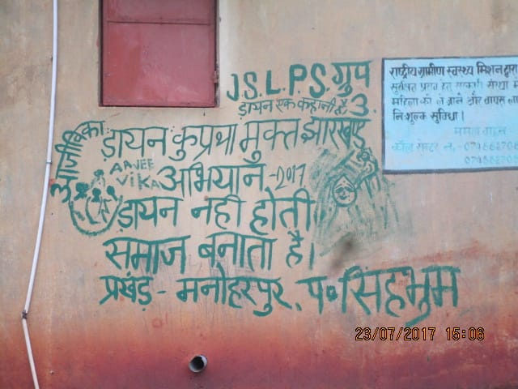
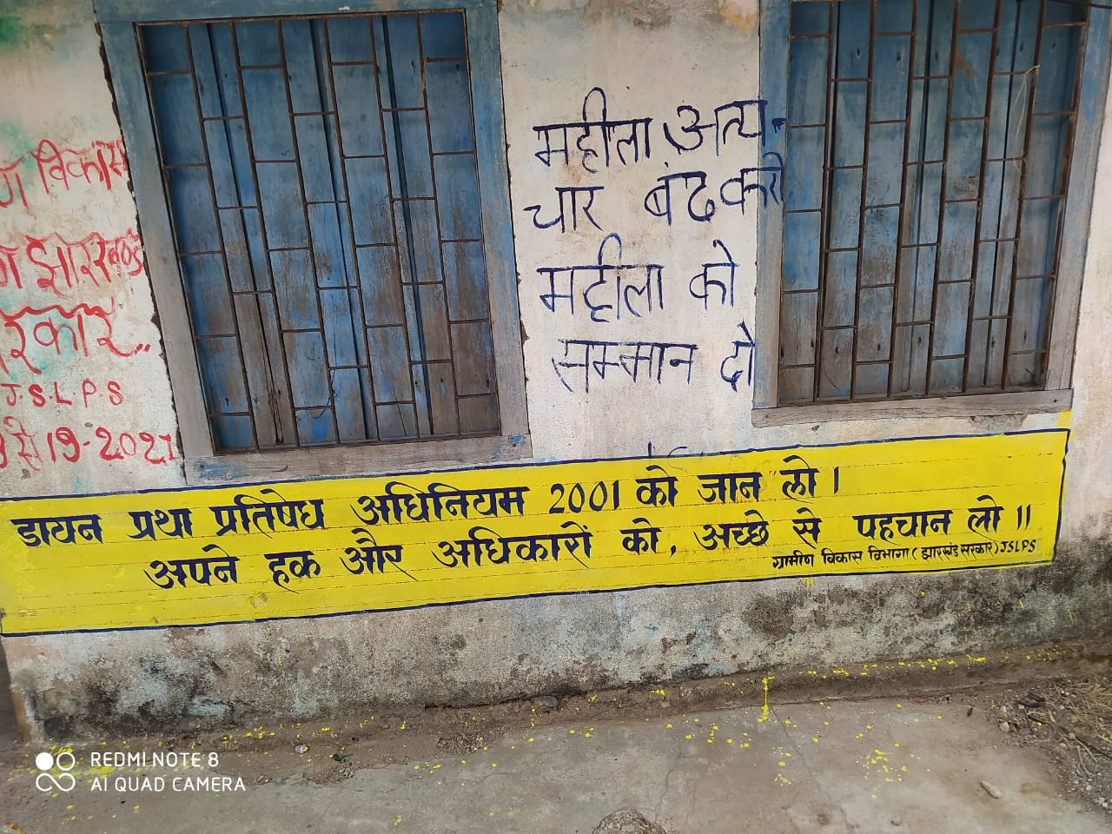
Wall Writing

Slide 9
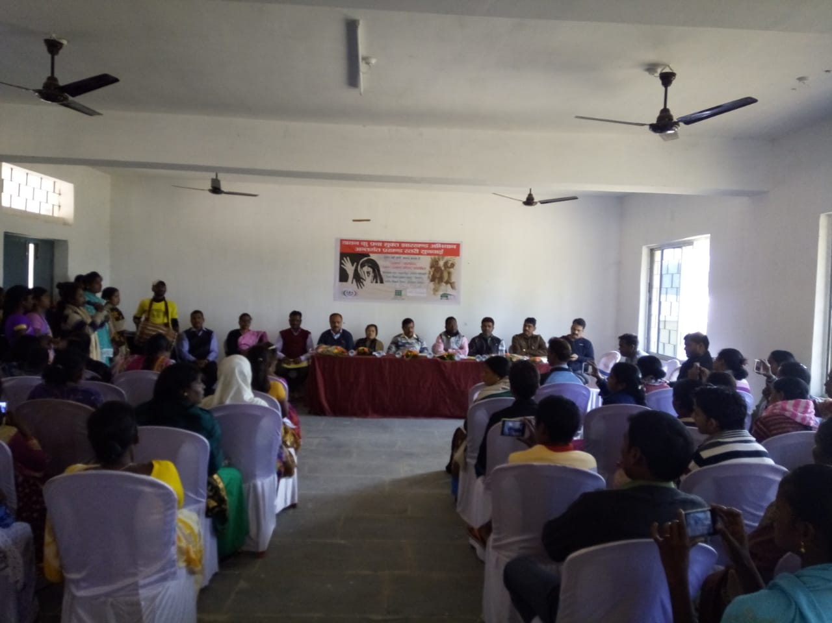
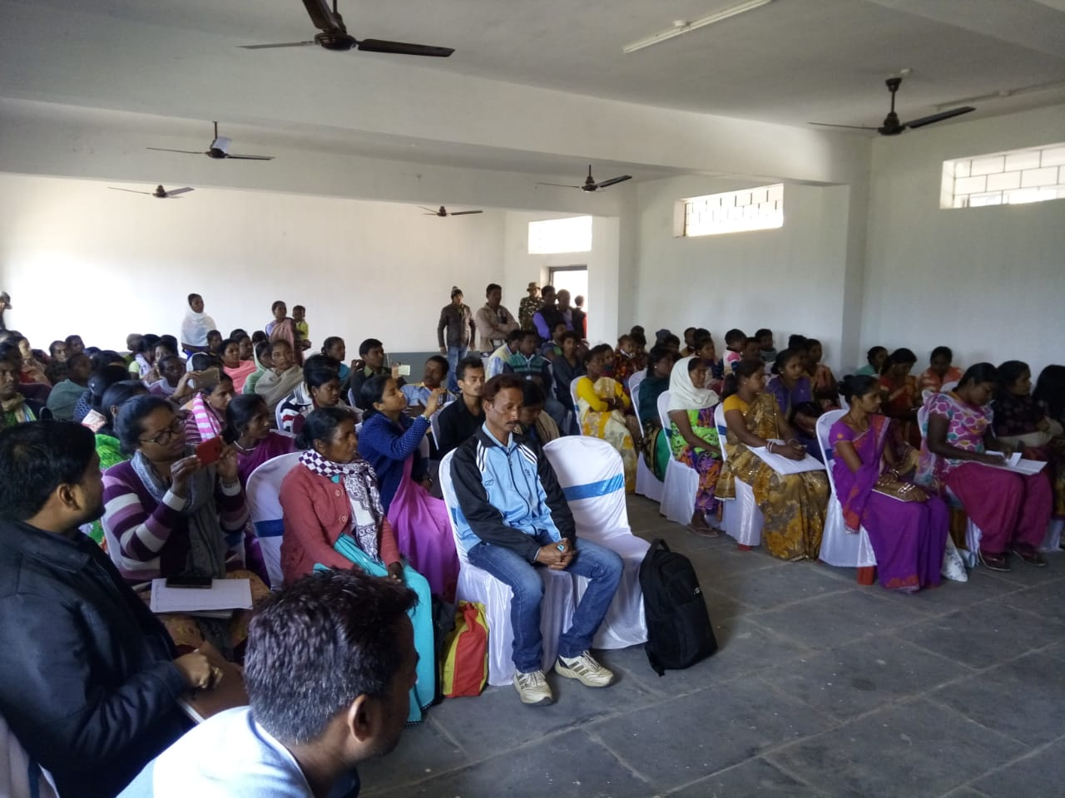
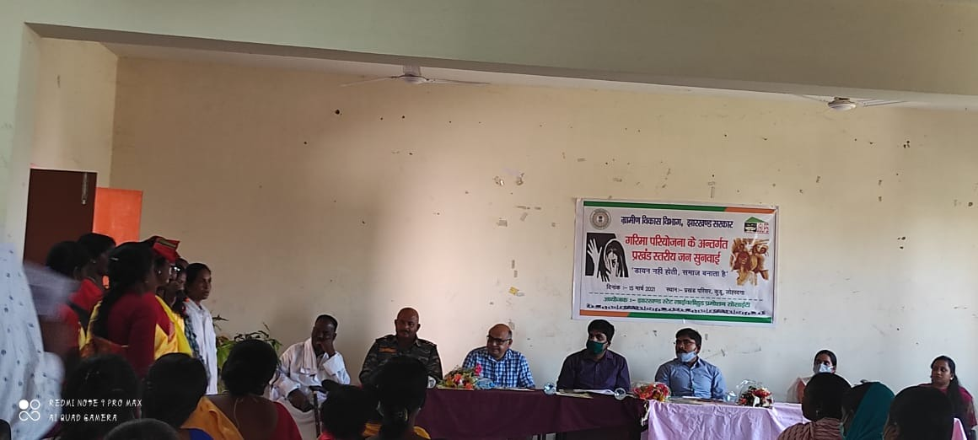
Public Hearing

Slide 10
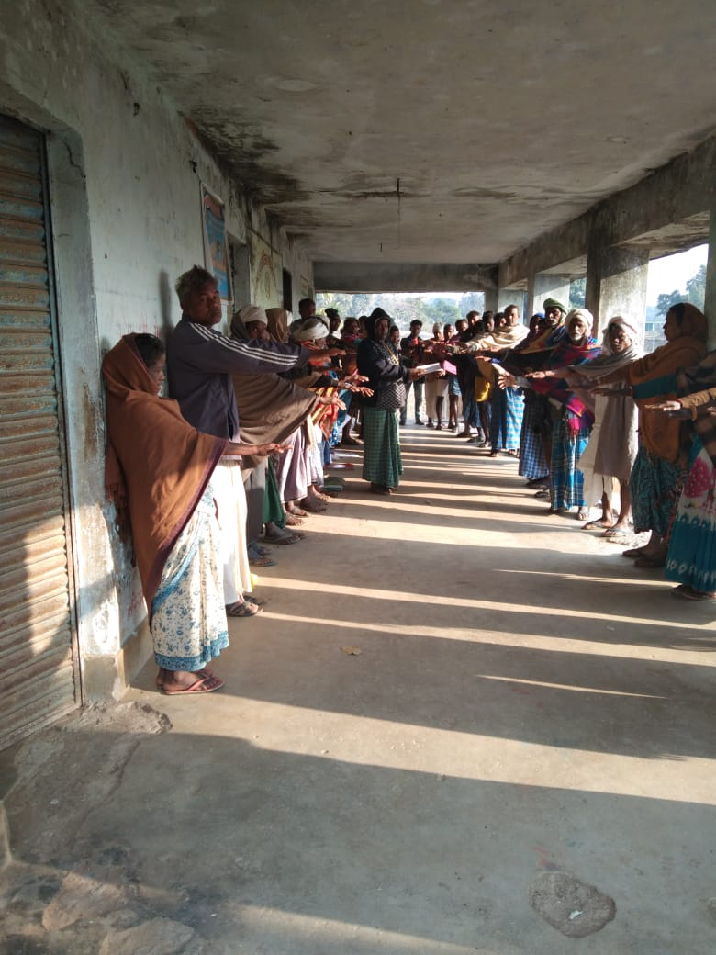
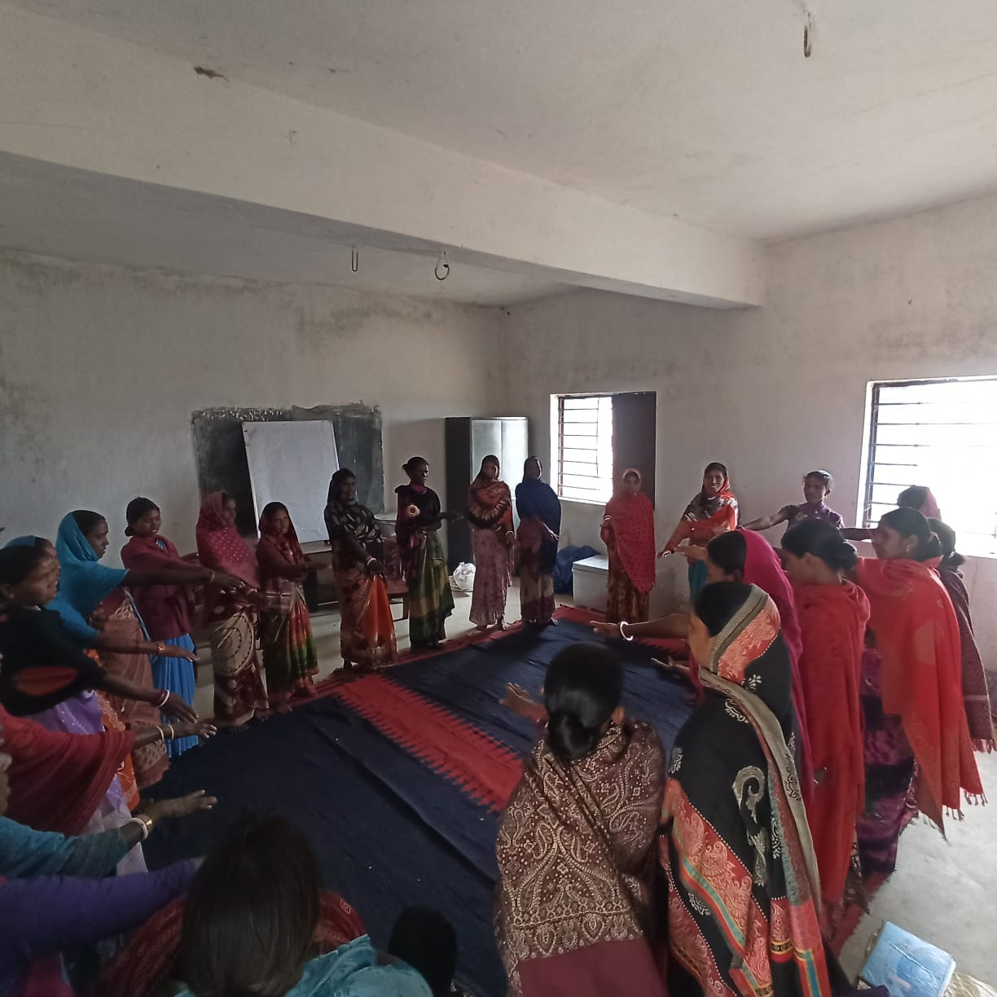
CBOs and Gram Sabhas are taking oath against Witch Hunting and Branding

Slide 11
Will these activities eliminate Witch Hunting?

Slide 12
There are two factors behind the Witch Hunting/Branding
E
External : Witch Doctors, Property Conspiracy, Availability of Education, health services, effectiveness of the Justice/Legal system, Women Safety status, Gender equality in the society etc.
Internal: Believe system, access to decision making, Voice in the family/society, economic independence, personal access to the legal, education, health services, Awareness regarding rights and entitlements, Gender sensitization within, etc.
I

Slide 13
Key Strategies
Prevention:
  Sensitization and capacity building of CLFs and VOs for leading the project
  Vulnerability Mapping and linking them with NRLM and other government schemes
  Formation of Protection Team at the village level for regular awareness generation and prevention activities.
  Introducing Witch Hunting Prevention in the training curriculum of different stakeholders
  Formation of Badlao Manch (Gender Forum) in every village and Badlao Didi in every SHGs
  Theatre of Oppressed approach for initiating dialogue in the villages
  Engagement with Youth and children
Protection and Justice:
  Adoption of Multiple approaches for identification of victims
  Formation of Special Cell at the Police Station with the help of TSA
  Establishing Community Managed One Stop Centres at the Block level.
  Conduction of Public Hearings at Block, District and state levels.
  Helpdesk for survivors and vulnerable families at the VO, Panchayat and CLF to ensure personalised services.
  Immediate Psychological and legal counselling and services
  Development of Survivor wise action plan for Livelihood promotion and other support
  Women Safety Audit

Slide 14
Contd..
Rehabilitation
  Linking with VRF
  Personalised Healing Services to Survivors
  Livelihood Plans and services through DAY-NRLM
Capacity Building Strategy
  Creating pool of Master Trainers at the state, district and block level from the community
  Pool of Resource Organisations and experienced persons at various level
  To evolve the Capacity Building Strategy for the key stakeholders
Monitoring Strategy
  Dash board to be created at the state level to track individual survivors.
  Joint Review Committee at State, District and Block Level.
  Evolving process guidelines and monitoring strategy.
  Development of norms for declaration of Village/GP and Block as ‘Witch Hunt Free’ by District administration

Slide 15
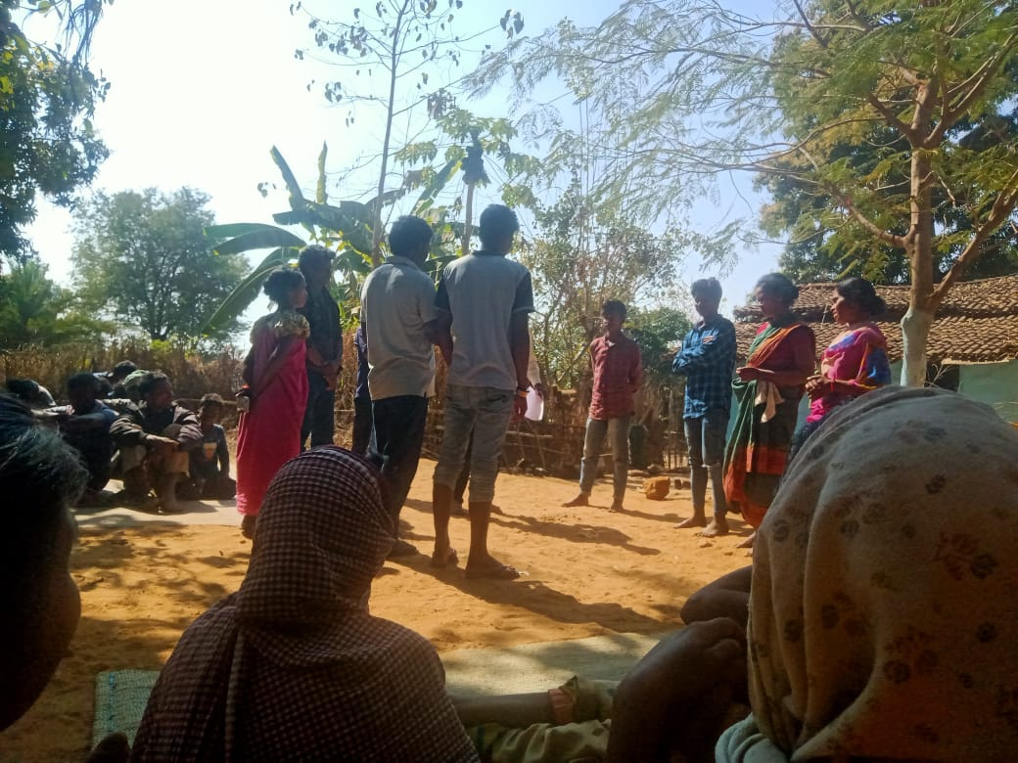
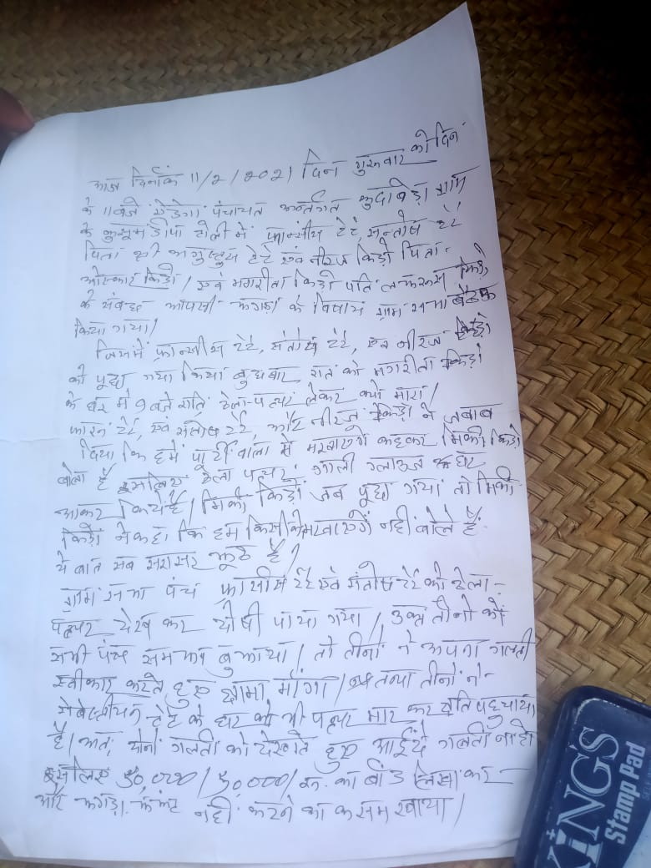
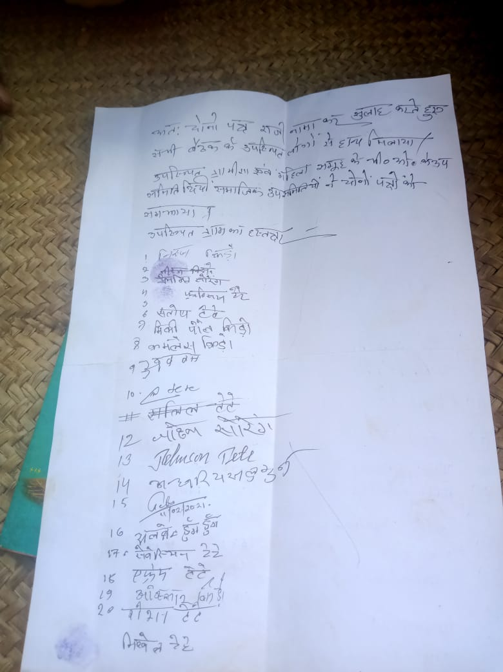
Cases are being solved by the community on the same day

Slide 16
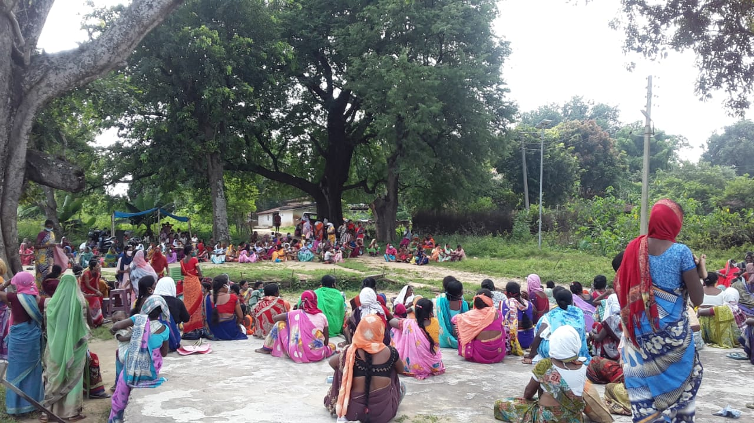
Survivors are being felicitated by the entire community

Slide 17
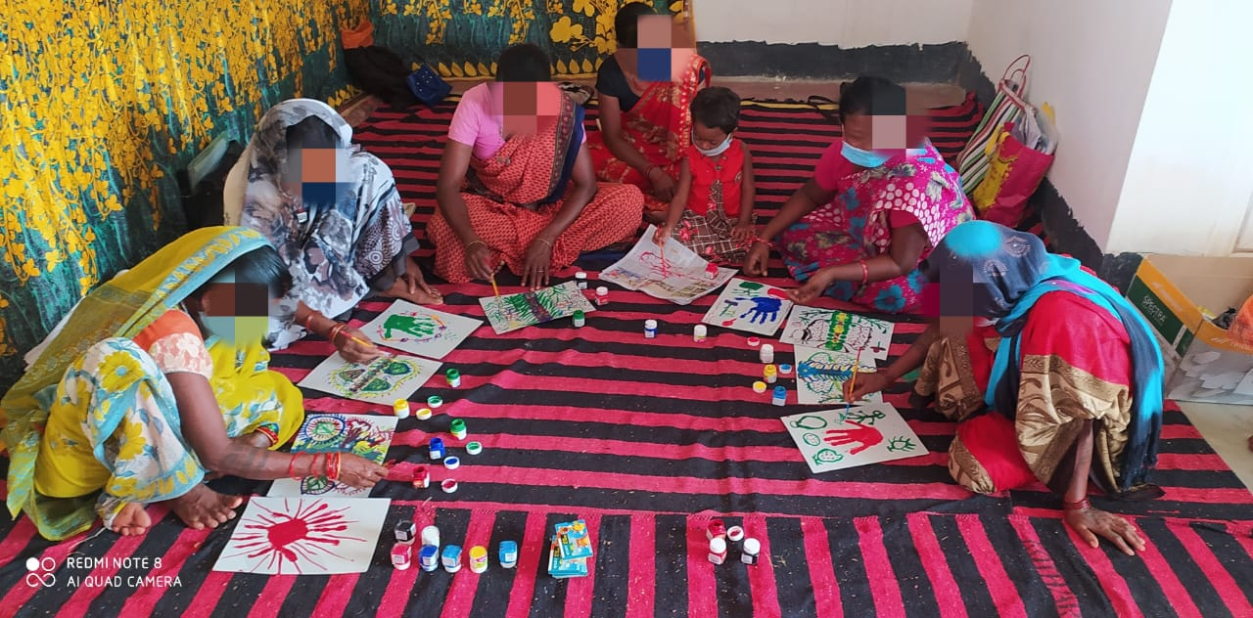
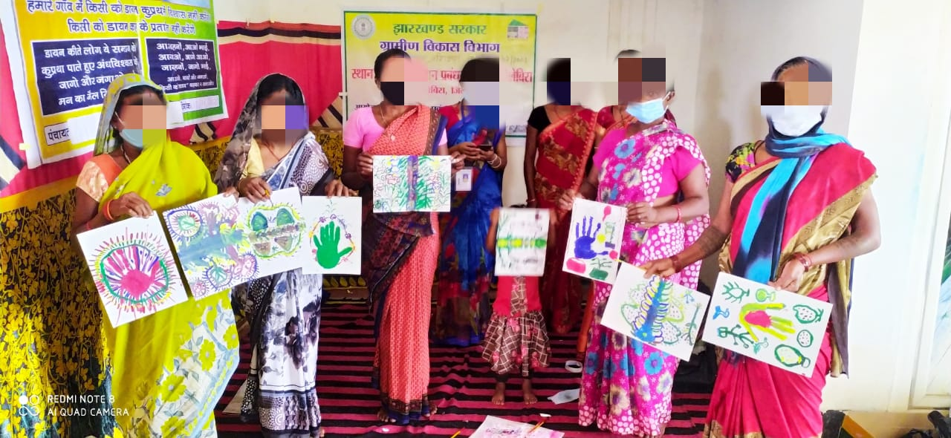
Healing of Survivors through Art Therapy

Slide 18
Some Analysis of the cases identified so far

Slide 19
Gender based analysis of the select 525 cases
Gender
Male | 11 | 2.1%
Female | 514 | 97.9%
Total | 525

Slide 20
Do you need to be old to be branded as witch?
Age | Female | Male
Average Age | 43 years | 47 Years
Age Range | 19 to 85 | 22 to 67

Slide 21
Marital Status and Witch Branding

Slide 22
Education Status and Witch Branding
Female literacy Rate in Rural Jharkhand: 49.75%

Slide 23
Intersectional analysis of the survivors

Slide 24
Economic Status of the Survivors
OCCUPATION
Agriculture | 77 | 14.7%
Labourer | 62 | 11.8%
Agriculture + Labourer | 363 | 69.1%
Others | 23 | 4.4%
Annual Income
Below Rs. 72000/Year | 450 | 85.71%
More than Rs. 72000 but less than 1.5 Lakh | 50 | 9.52%
Data Not Available | 25 | 4.76%
Jharkhand has the second highest poverty rate in India as per World Bank Report-2012

Slide 25
The analysis is to share with the Government :-
To deviate the Witch Hunting Prevention interventions from awareness generation to some serious interventions establishing accountability.
Invest in deeper research and bring on board several players
Invest in women empowerment and strengthening the Judicial system.

